Slide 1
Vendor Name and Publix

Slide 2
Agenda Items Suggested to Include
Brand Overview (short history)
History
Demographic/consumer information
Syndicated data review
Conventional and natural
Include specific to the SE region
Assortment
Pricing/Retail review
Promotional Program (remember Publix has a high/low strategy)

Slide 3
History
We were founded because….
Timeline
We believe in….
We serve a need in this way…..
We are different because….
Here is our consumer…..
We are growing because….
Note special attributes like “local” or “minority owned”

Slide 4
Syndicated Data Review
SPINS ranking (National data is good but Southeast data is preferred)
Natural
Conventional
Growth pattern
Other retails selling the product

Slide 5
Assortment Recommendations
Include order of recommendations
Include sales projections
Include UPCs
Include pictures
Merchandising recommendations
Certifications (Non GMO, Fair Trade, etc.)

Slide 6
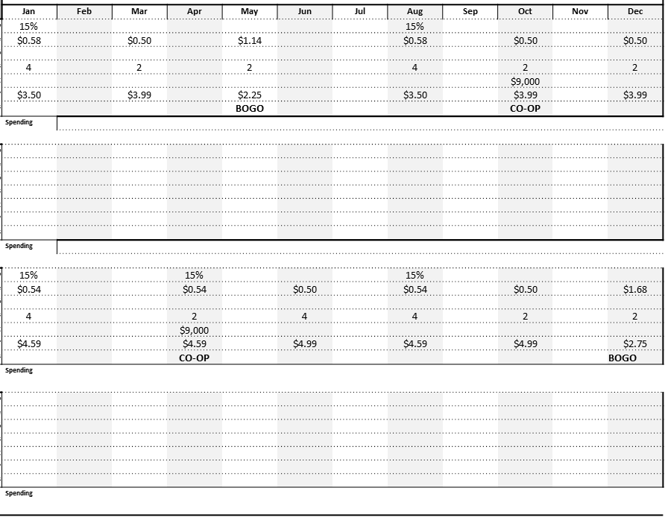
Pricing and Promo
Suggested retails
Suggested promo retails that produce turns
Promotional calendar

Slide 7
In Summary
Last thought on why you should be in Publix along with the list of items recommended.
This becomes a reference page for buyer so they don’t have to hunting for the recommendations within the deck.

Slide 8
THANK YOU!

